Slide 1

SPACE X Data Analysis

Slide 2
INTRO
We are using a SPACEX data set to explore their data
§ Data Collection/Data Wrangling
• data collection and data wrangling methodology related slides (1 pt)
• EDA and interactive visual analytics methodology related slides (3 pts)
• Predictive analysis methodology related slides (1 pt)
• EDA with visualization results slides (6 pts)
• EDA with SQL results slides (10 pts)
• Interactive map with Folium results slides (3 pts)
• Plotly Dash dashboard results slides (3 pts)
• Predictive analysis (classification) results slides (6 pts)
• Conclusion slide (1 pts)
• Applied your creativity to improve the presentation beyond the template (1 pts)

Slide 3
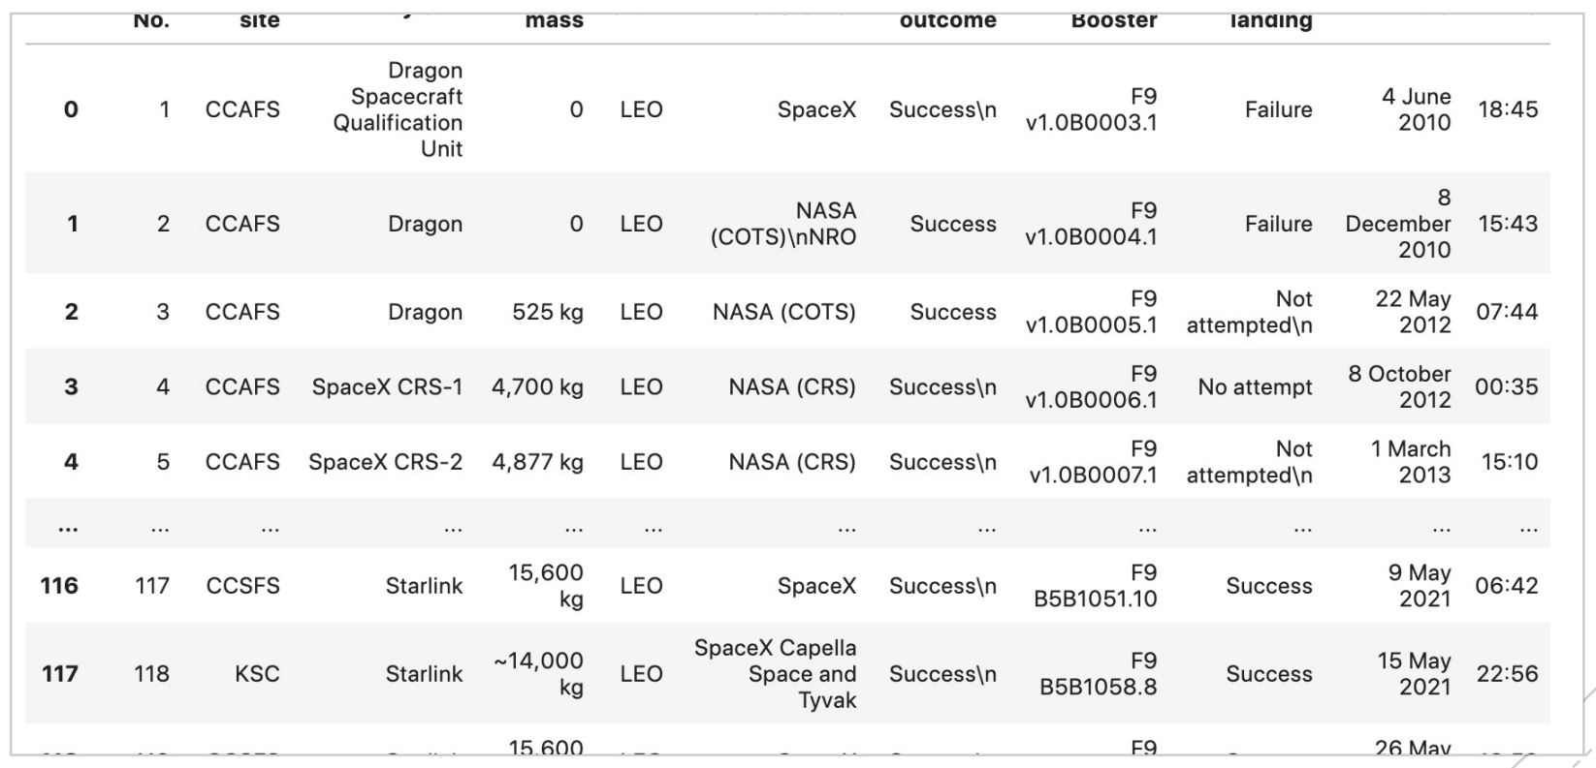
Data Collection/Data Wrangling
Scraped their data
§ Organized their data into dataframes
§ Filter and Clean Data

Slide 4
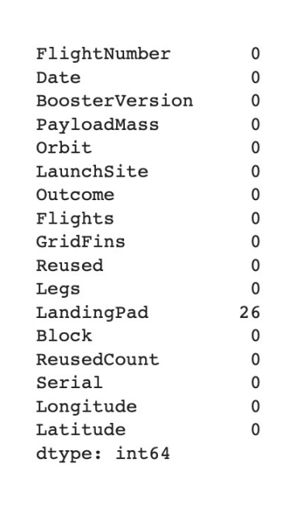
EDA Interactive Visual Analytics

Slide 5
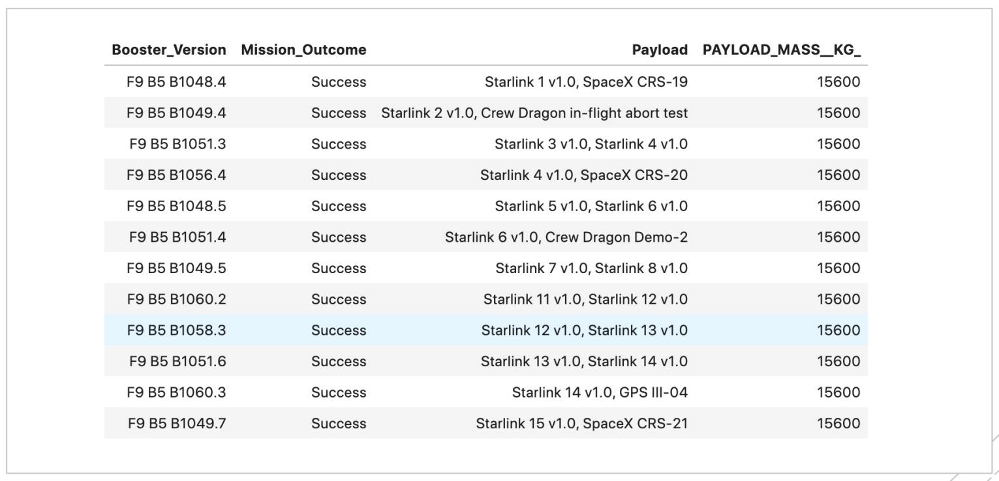
EDA with SQL Results
§ EDA with SQL
§ Used SQL to create tables

Slide 6
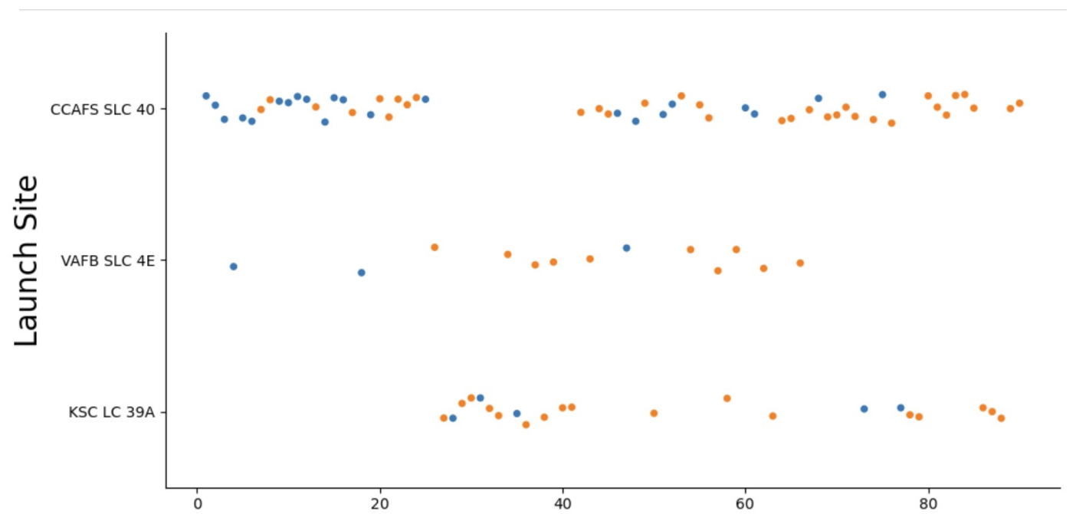
EDA with Visualization

Slide 7
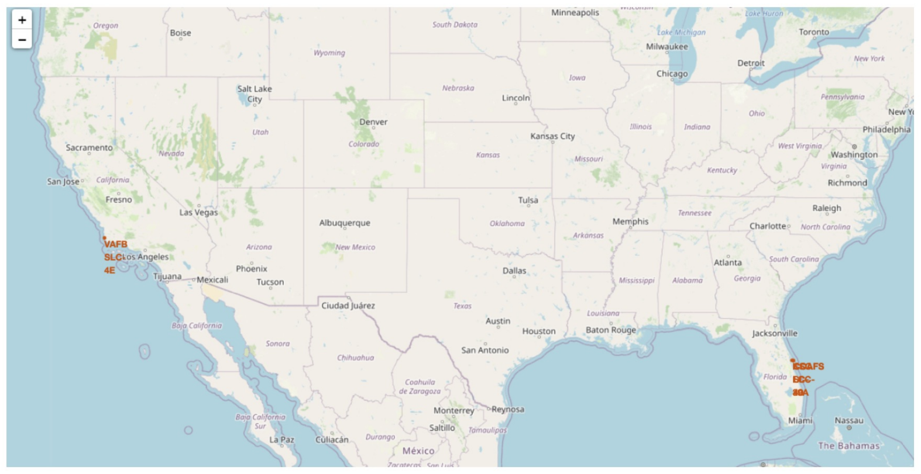
Folium Interactive Maps

Slide 8
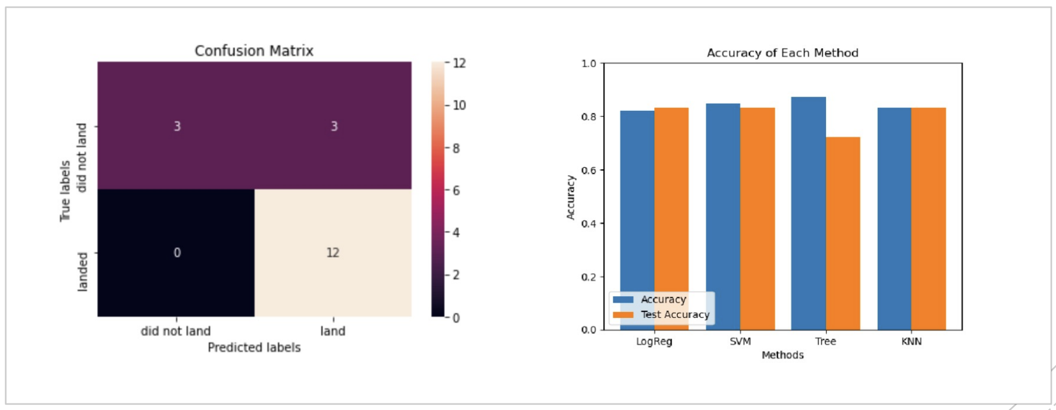
Machine Learning
§ Created training and testing models that created a training set that the data could be predicted from in the testing set
§ Tree was the most accurate for training and least for testing

Slide 9
THE END ☺

